Slide 1




Model 01 - Software service providing
This profit structure is charge collection after give “Photome MIS” service to clients on our server machine.
We can expect fixed monthly income.
Virtual Server
MIS
MIS
MIS
MIS
MIS
Advantages
Disadvantages
Expectation of fixed monthly income.
Apply difference price policy to each client flexibly.
Heavy burden for maintenance.
Difficult to manage clients.

Slide 2


Model 02 - Software package delivery to clients
Developing and setup Photome MIS on client’s server by project contract.
MIS
MIS
Software develop
→ delivery after customizing
MIS
MIS
MIS
Advantages
Disadvantages
Apply difference price policy to each client flexibly.
Best profit structure among 3 models.
Possible to be work for customizing by customer’s server.
Difficult to manage clients.
Need strong sales capacity.

Slide 3
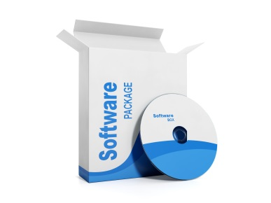
Model 03 - Software package delivery to head office
Developing and package delivery to Photome head office including all rights.
delivery
Photo-Me International
Head office
Software develop & packaging
Advantages
Disadvantages
Simple profit structure.
Low income expected.

